Slide 1

Dog Breed Identification Using Deep Learning
B.TECH 2022-26 5TH SEM LEARNING PROJECT
Submitted by
Gananath Tripathy, Deepak Choudhary, Aditya Patra
RollNo- 22CSE729,22CSE480,22CSE943
Under the Guidance of Asst. Prof. Rajendra Kumar Mahanta
BACHELOR IN TECHNOLOGY
DEPARTMENT OF COMPUTER SCIENCE & ENGINEERING
SCHOOL OF ENINEERING & TECHNOLOGY
GANDHI INSTITUTE OF ENGINEERING & TECHNOLOGY UNIVERSITY
GUNUPUR -765022, ODISHA

Slide 2
Objective
Introducation
Requirement
Working Principle
Data Flow Diagram
Conclusion

Slide 3
OBJECTIVE
Accurate Classification: The primary objective of dog breed prediction using the Inception V3 model is to accurately classify images of dogs into their respective breeds. This involves distinguishing between subtle differences among various dog breeds.
Feature Extraction: The model uses the Inception V3 architecture to effectively extract hierarchical features from images, capturing everything from basic edges to complex patterns, which are essential for accurate breed identification.

Slide 4
INTRODUCTION
Model Overview : The Inception V3 model is a state-of-the-art deep learning architecture designed for image recognition tasks, including dog breed classification. It excels at analyzing complex visual data, making it an ideal choice for distinguishing between various dog breeds.
Objective Statement : The primary goal of using the Inception V3 model in dog breed prediction is to achieve highly accurate classification of dog images, enabling precise identification of breeds, even when the differences are subtle.
Advanced Feature Extraction : Inception V3 leverages a sophisticated convolutional neural network structure to extract detailed and hierarchical features from images. This allows the model to recognize intricate patterns and characteristics unique to each dog breed.
Real-World Application : The dog breed prediction model is designed for practical applications such as pet adoption platforms, veterinary assistance, and security systems, where accurate breed identification is crucial.
Continuous Improvement : The model can be fine-tuned and adapted to include more breeds, improve classification accuracy, and cater to specific user needs, ensuring it remains effective in various environments and use cases.

Slide 5
WORKING PRINCIPLE
Image Input and Preprocessing: The Inception V3 model begins by accepting images of dogs as input. These images are preprocessed through resizing, normalization, and data augmentation to ensure consistency and improve the model’s ability to generalize across different conditions and lighting.
Convolutional Layers: The model employs a series of convolutional layers that extract hierarchical features from the images. These layers progressively capture basic features like edges and textures, followed by more complex patterns, shapes, and breed-specific characteristics.
Inception Modules: At the core of Inception V3 are the Inception modules, which utilize multiple convolutional filters of different sizes in parallel. This enables the model to efficiently capture diverse aspects of the image at various scales, enhancing its ability to differentiate between dog breeds.
Global Average Pooling: After the feature extraction process, the model applies global average pooling to condense the information, reducing the dimensionality while preserving the essential features necessary for classification.
Fully Connected Layers and Softmax Classification: The processed features are passed through fully connected layers, where the model learns to map these features to specific dog breeds. The final softmax layer outputs a probability distribution over all possible breeds, predicting the most likely breed for the given image.
Model Optimization and Training: Inception V3 is trained using large datasets of labeled dog images. The training process involves optimizing the model’s weights through backpropagation, minimizing the error between predicted and actual labels, and improving its accuracy over time.
Real-Time Prediction: Once trained, the model can be deployed to make real-time predictions on new, unseen dog images. It quickly processes the image through the learned layers, outputting the predicted breed with high confidence.

Slide 6
Software Requirements :-The software requirements for the dog breed prediction project using the Inception V3 model include Python as the primary programming language, with TensorFlow or PyTorch for implementing the neural network. Essential libraries include PIL for image processing and Pandas and NumPy for data handling. CUDA and cuDNN are recommended for GPU acceleration. A suitable IDE like PyCharm or Jupyter Notebook is needed for development, and Git for version control. Additionally, managing dependencies withpip or conda is crutial
HARDWARE REQUIREMENTS:-
Operating system- Windows 10 or later
Memory – 4GB minimum, 8GB recommended or more
Processor – Intel i3 or above
We recommend updated Web Browser.
Ethernet connection (LAN) or a wireless adapter (WIFI)

Slide 7
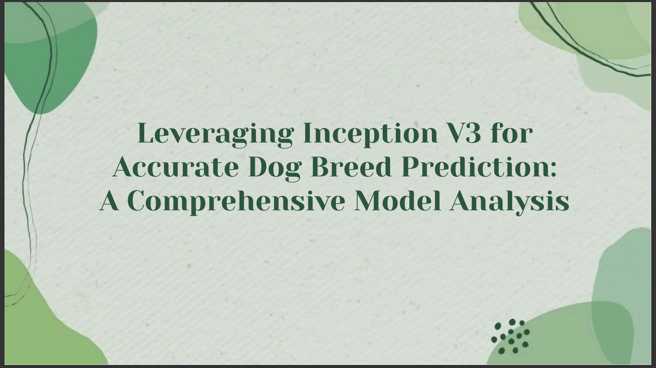

Slide 8
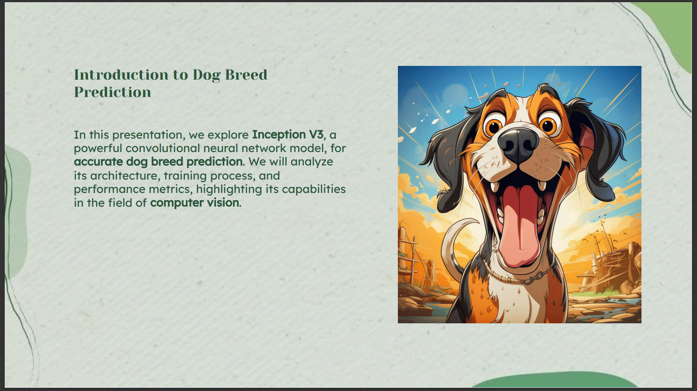

Slide 9
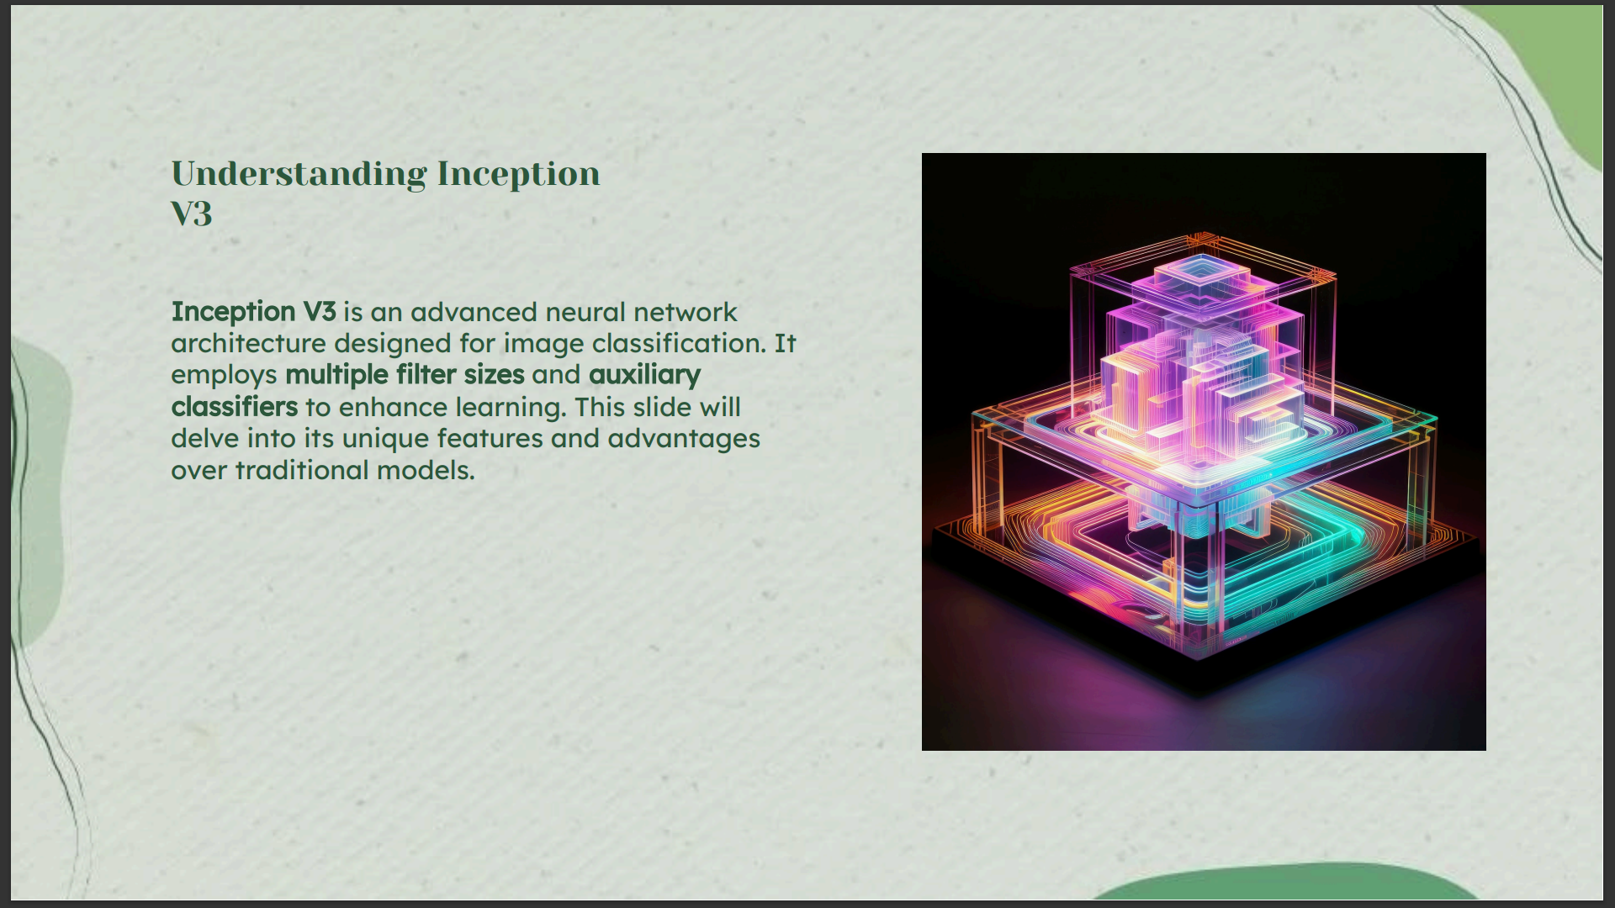

Slide 10
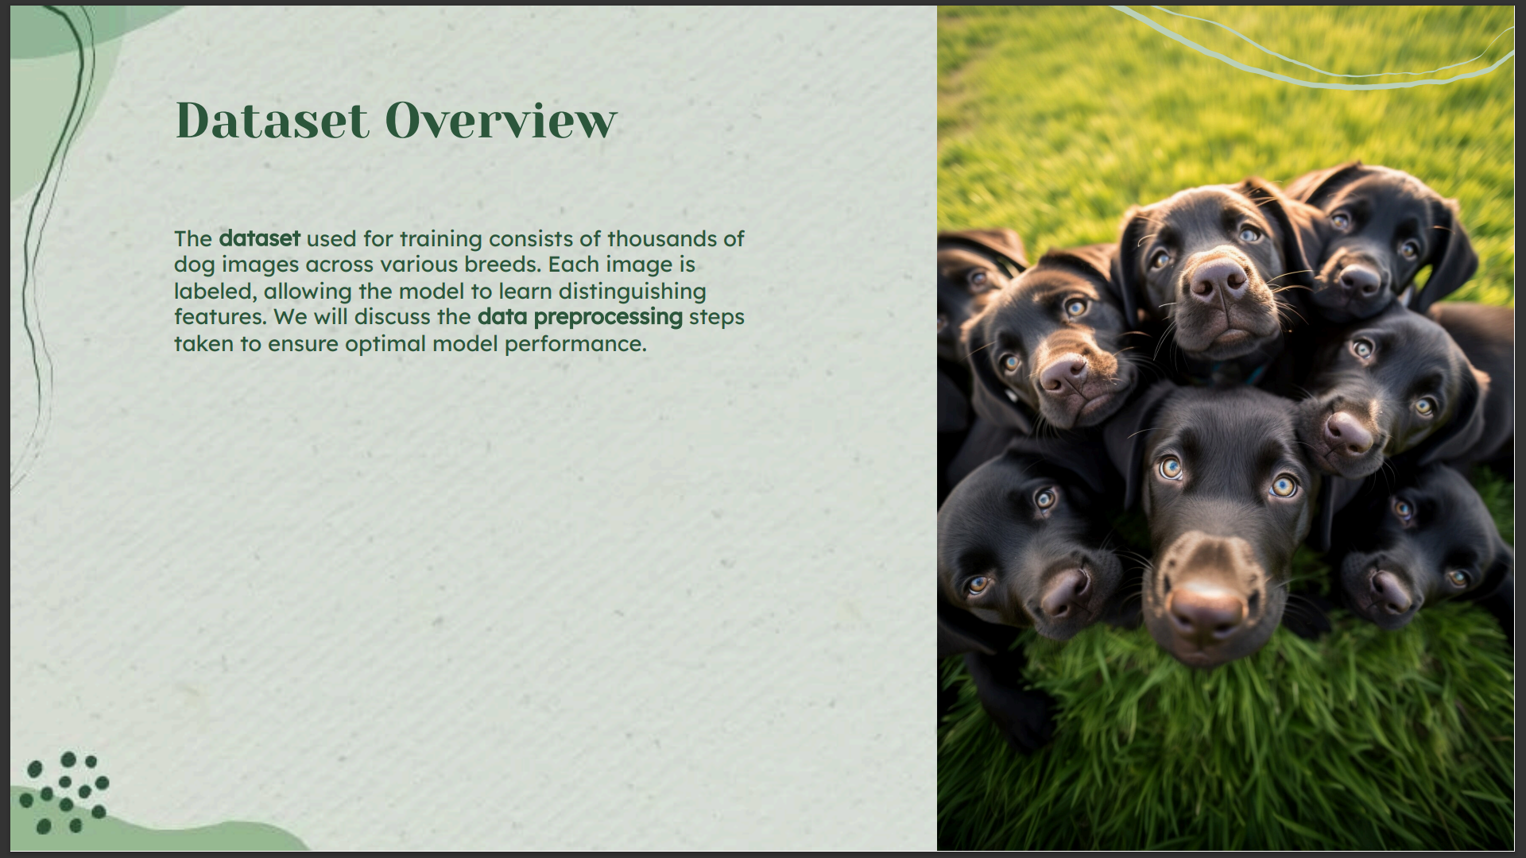

Slide 11
Flow Chat Layout :
start
Forward Propagation
Prediction Layer
Input Image
Classify Dog Breed
Processing
Output Prediction
Load Inception V3
End

Slide 12
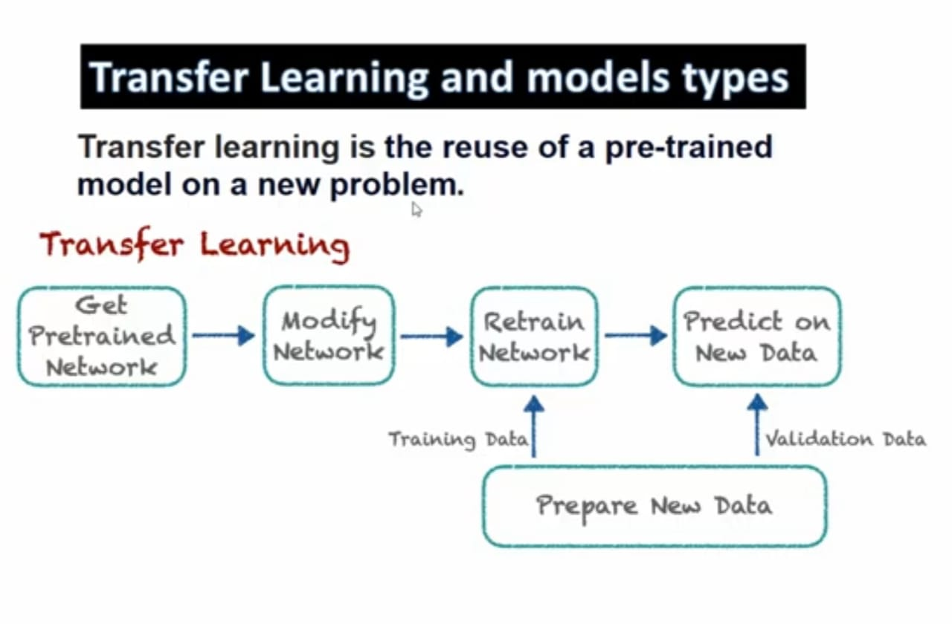

Slide 13
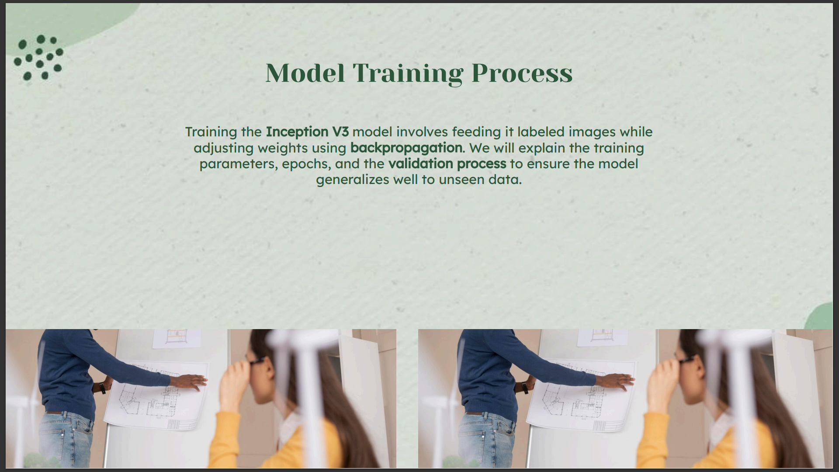

Slide 14
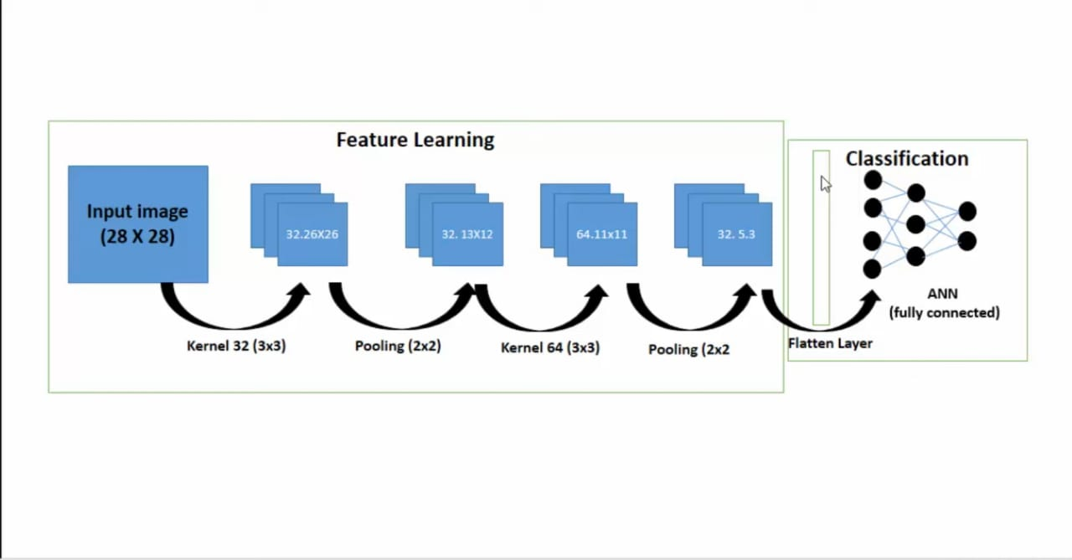

Slide 15
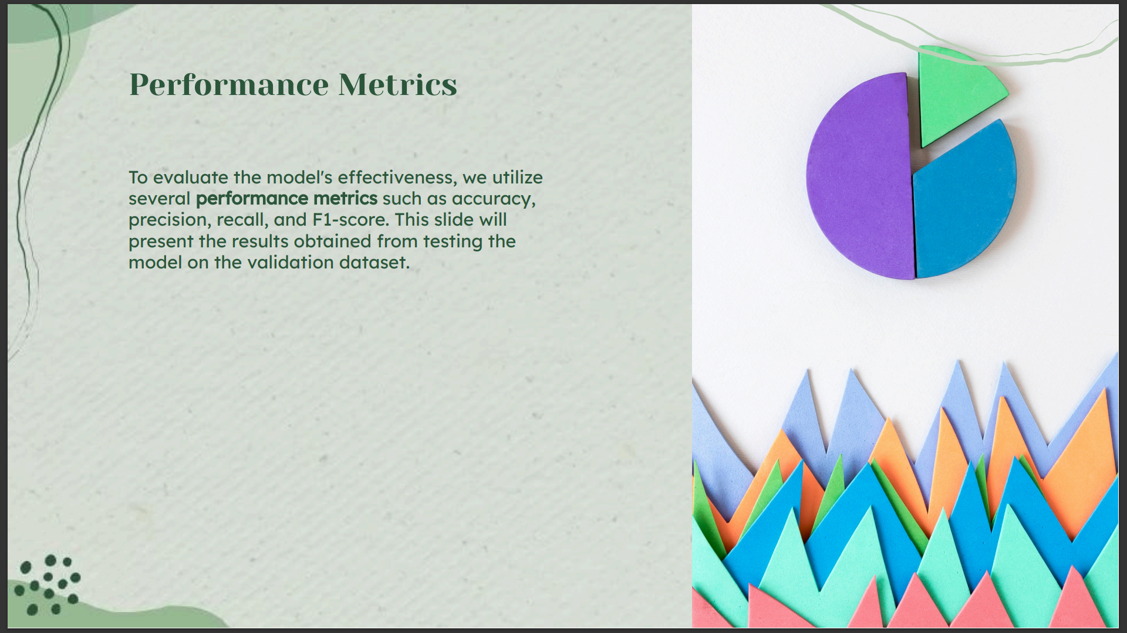

Slide 16
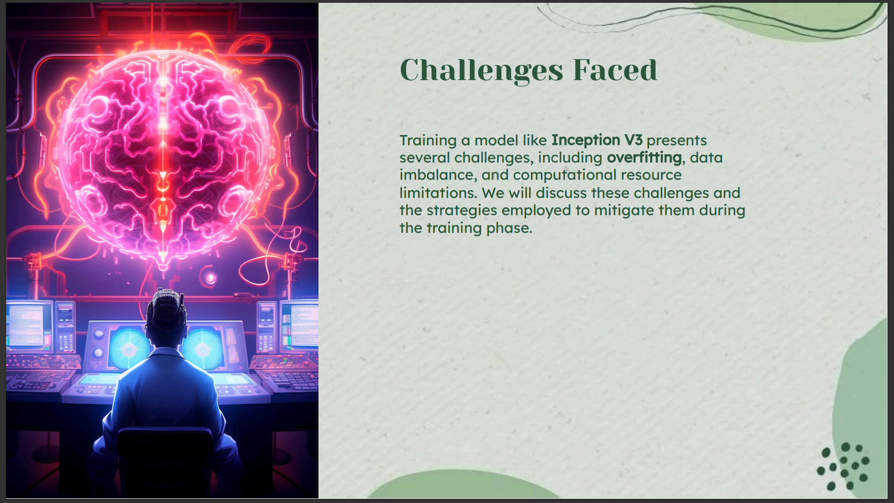

Slide 17
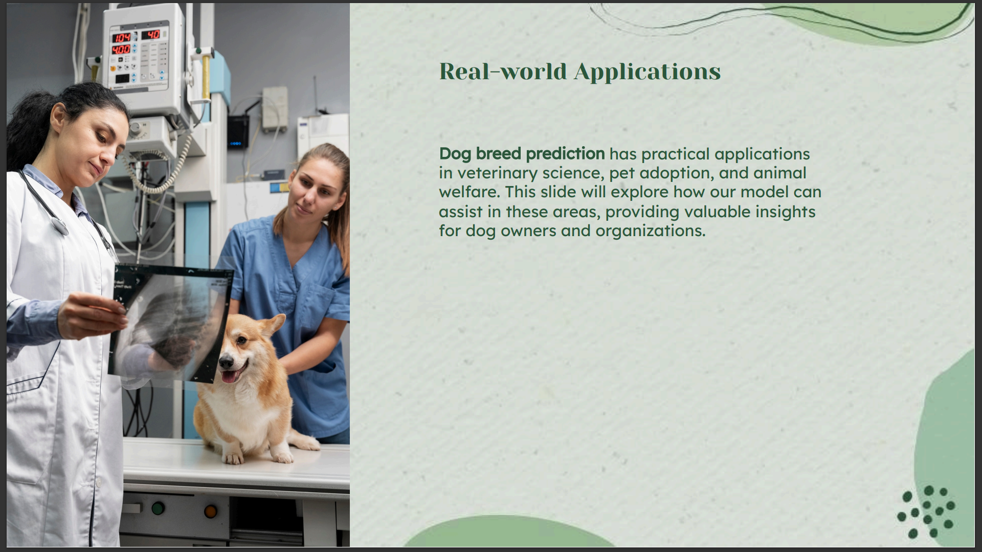

Slide 18
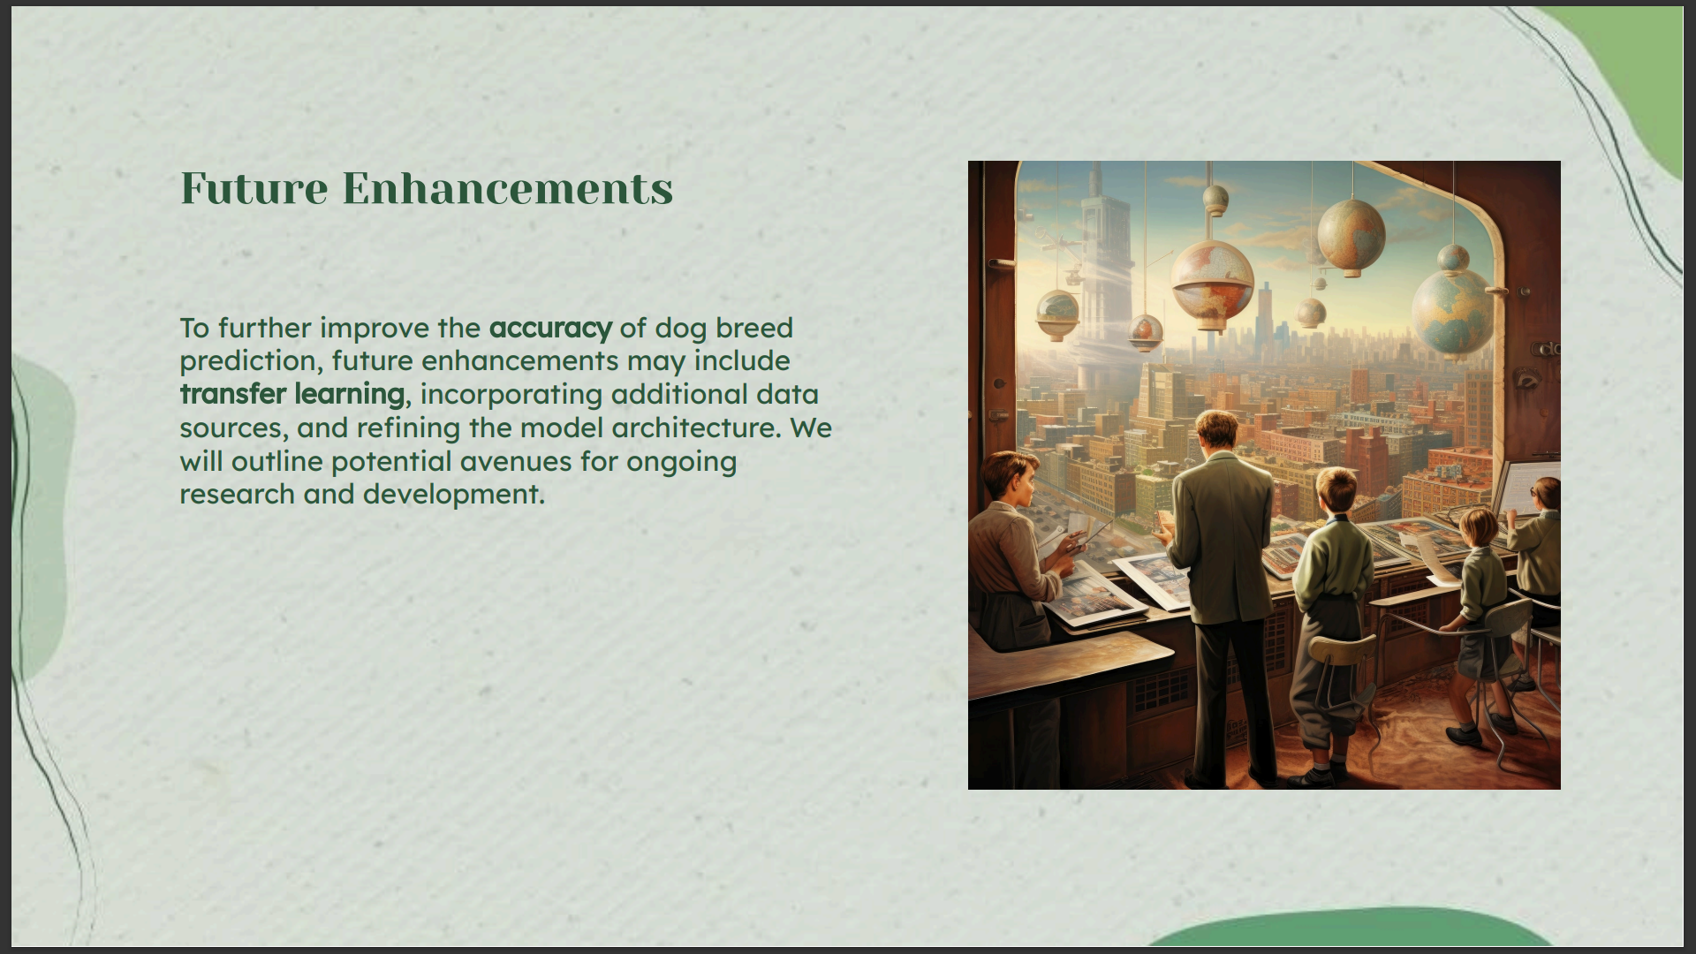

Slide 19
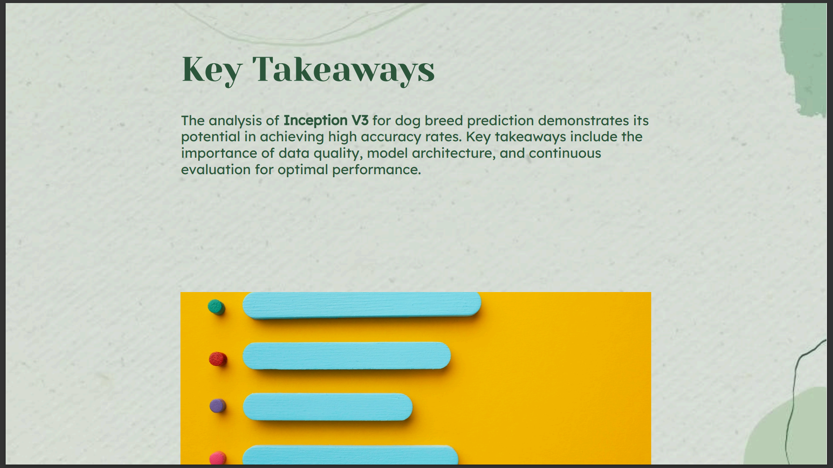

Slide 20
